Slide 1
Discrete-Time Signal Description
M. J. Roberts - All Rights Reserved. Edited by Dr. Robert Akl
‹#›

Slide 2
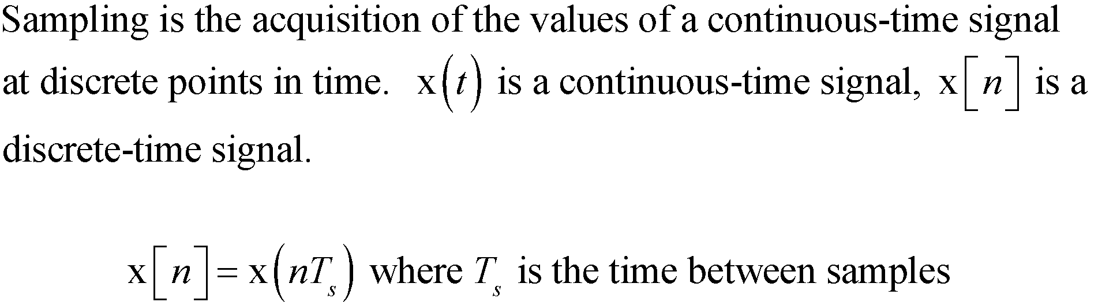
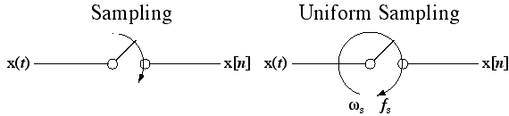
Sampling and Discrete Time
M. J. Roberts - All Rights Reserved. Edited by Dr. Robert Akl
‹#›

Slide 3
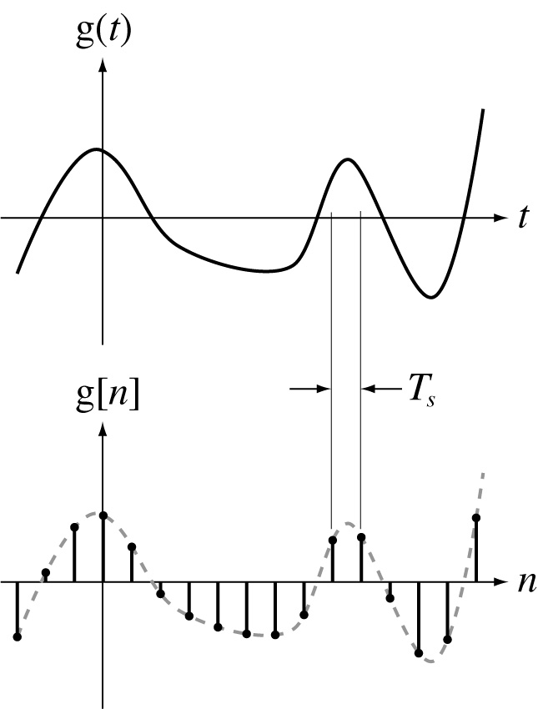
Sampling and Discrete Time
M. J. Roberts - All Rights Reserved. Edited by Dr. Robert Akl
‹#›

Slide 4
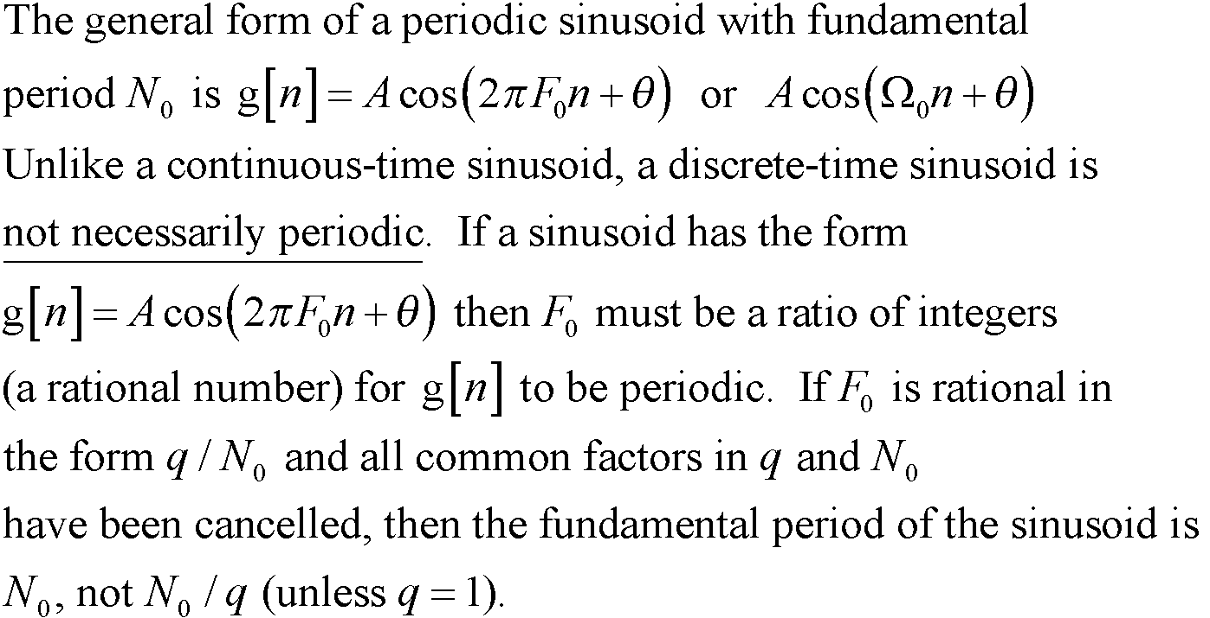
Sinusoids
M. J. Roberts - All Rights Reserved. Edited by Dr. Robert Akl
‹#›

Slide 5
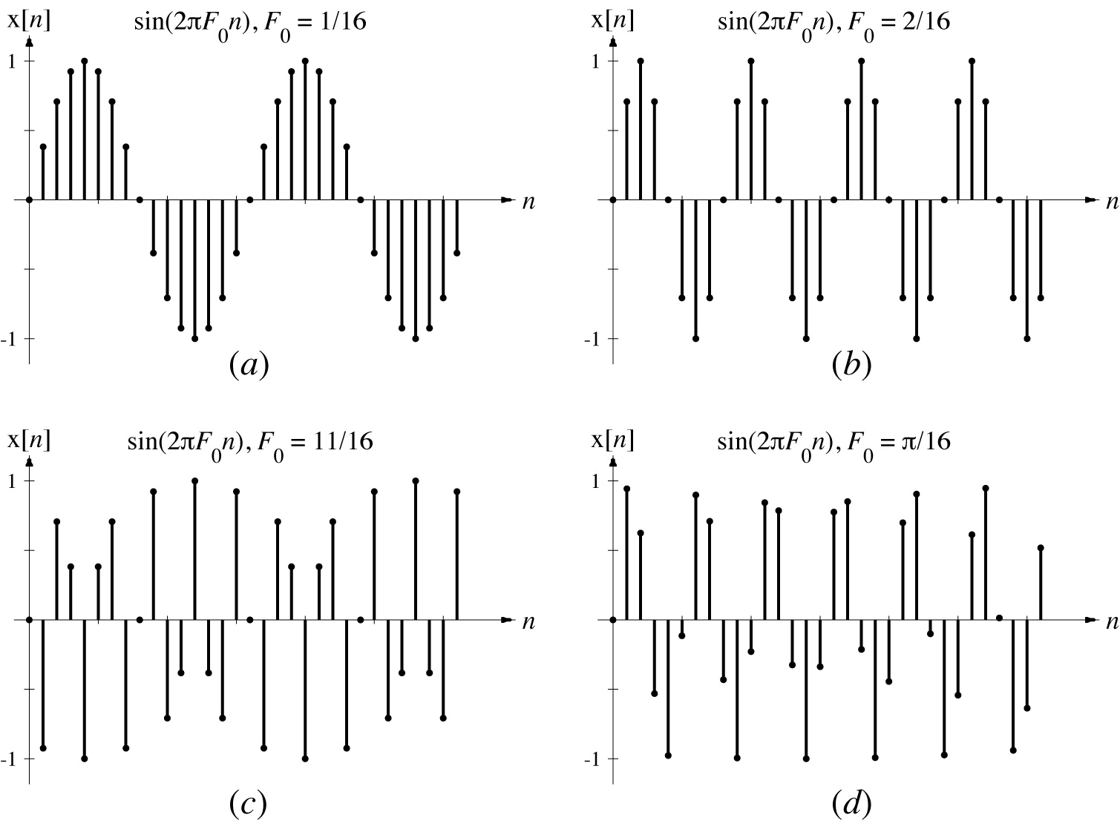
Sinusoids
Periodic
Periodic
Periodic
Aperiodic
M. J. Roberts - All Rights Reserved. Edited by Dr. Robert Akl
‹#›

Slide 6
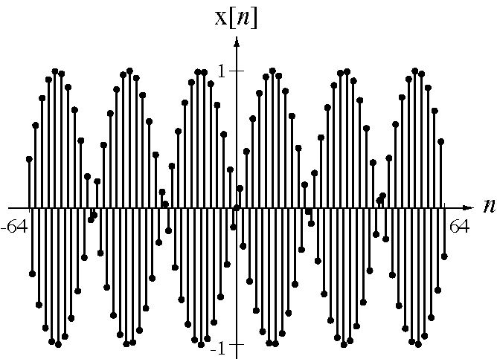
Sinusoids
An Aperiodic Sinusoid
M. J. Roberts - All Rights Reserved. Edited by Dr. Robert Akl
‹#›

Slide 7
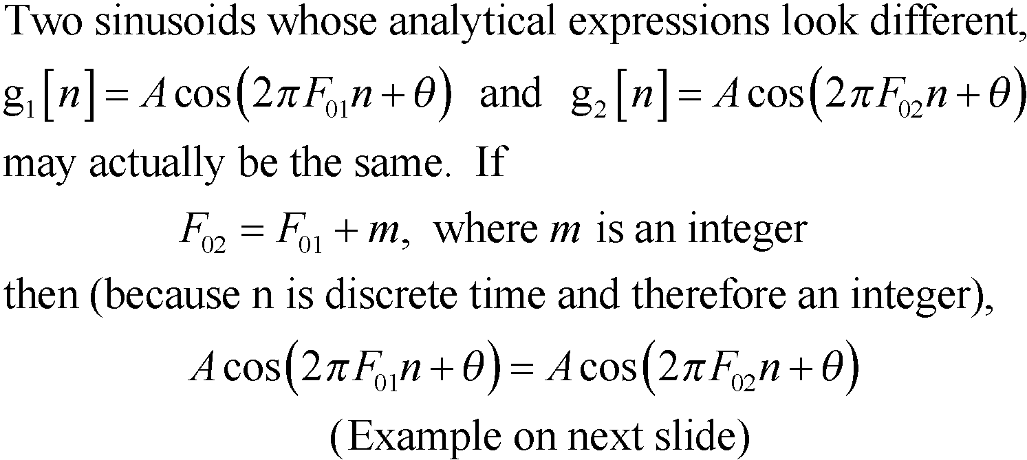
Sinusoids
M. J. Roberts - All Rights Reserved. Edited by Dr. Robert Akl
‹#›

Slide 8
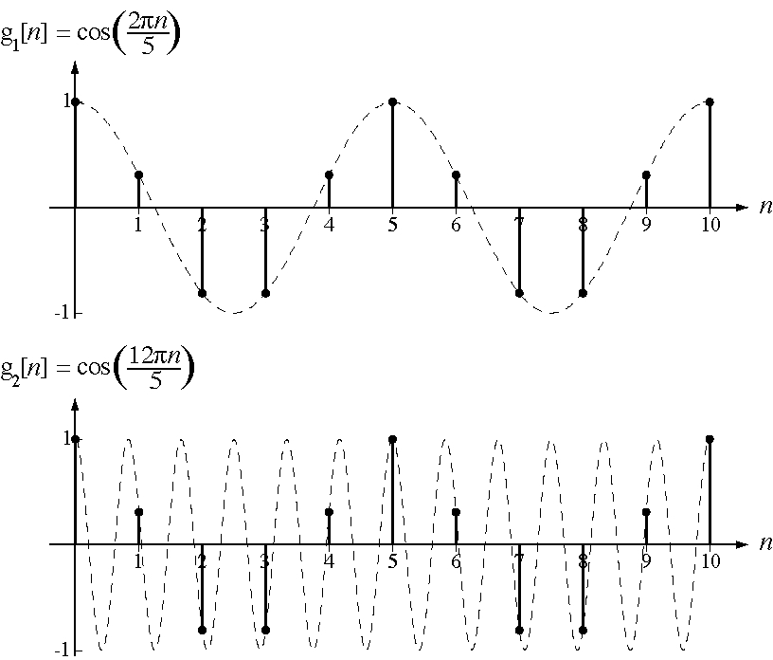
Sinusoids
M. J. Roberts - All Rights Reserved. Edited by Dr. Robert Akl
‹#›

Slide 9
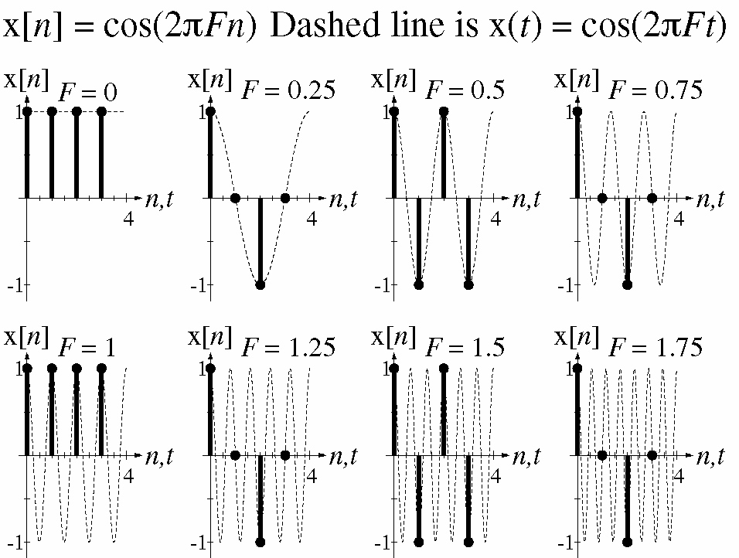
Sinusoids
M. J. Roberts - All Rights Reserved. Edited by Dr. Robert Akl
‹#›

Slide 10
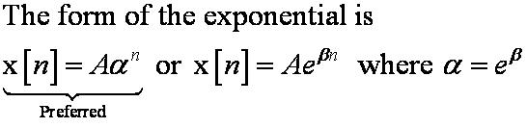
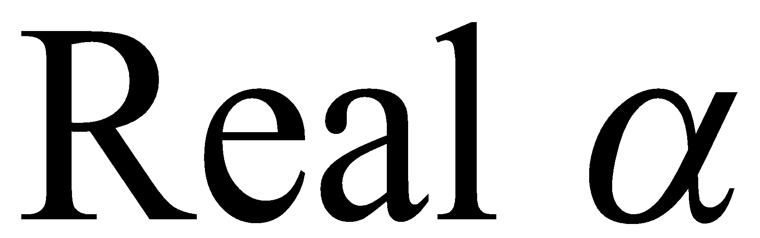
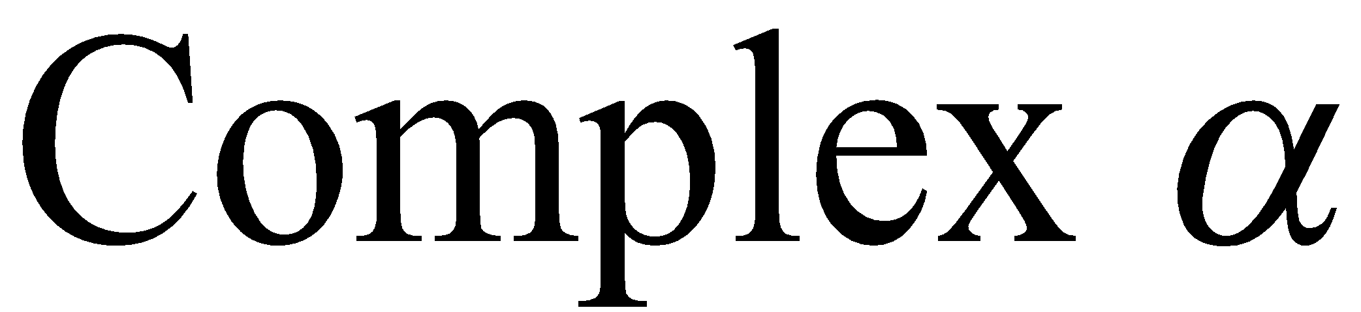
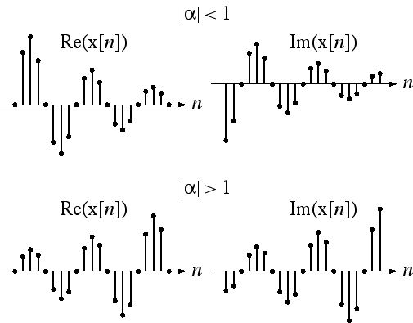
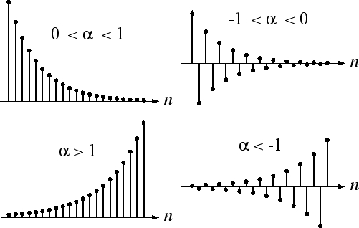
Exponentials
M. J. Roberts - All Rights Reserved. Edited by Dr. Robert Akl
‹#›

Slide 11
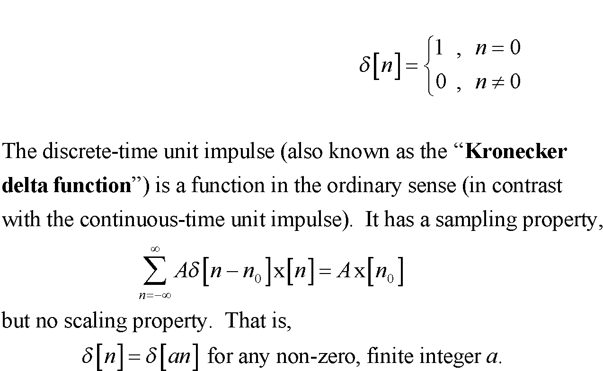
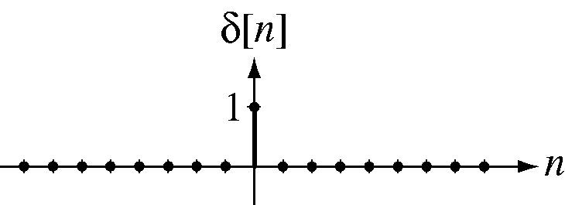
The Unit Impulse Function
M. J. Roberts - All Rights Reserved. Edited by Dr. Robert Akl
‹#›

Slide 12
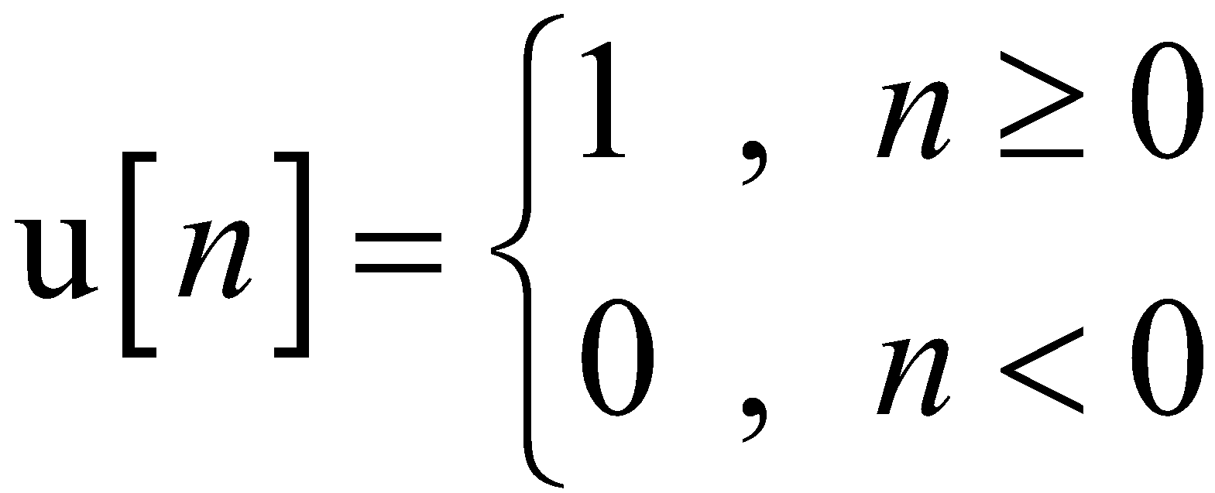
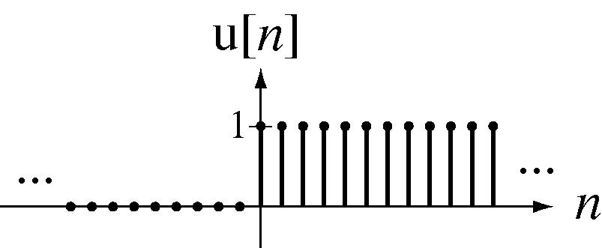
The Unit Sequence Function
M. J. Roberts - All Rights Reserved. Edited by Dr. Robert Akl
‹#›

Slide 13
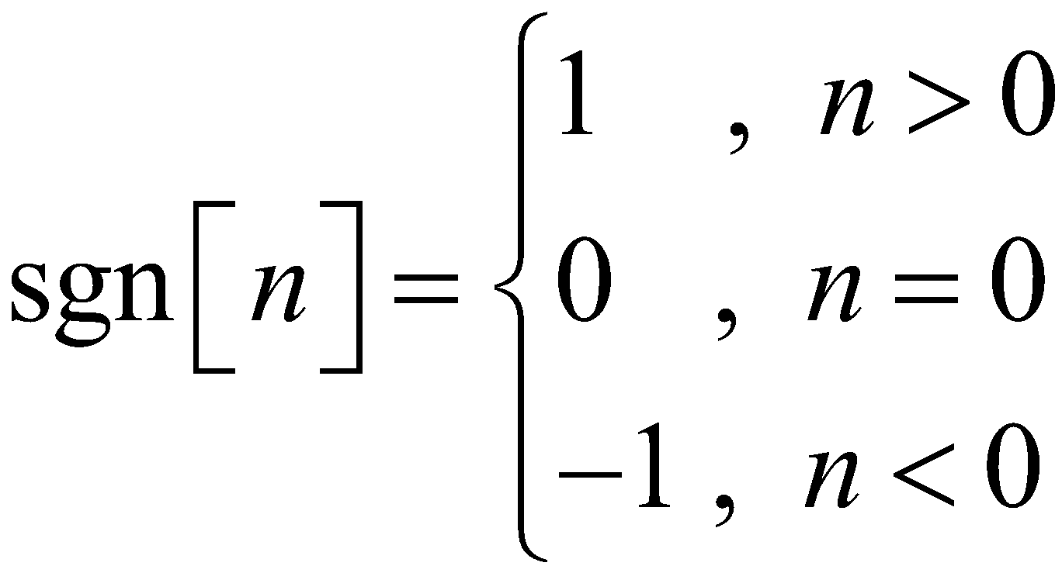
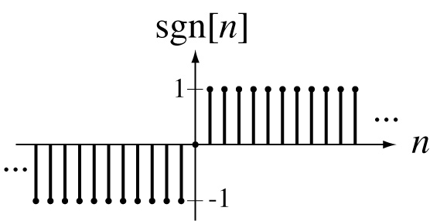
The Signum Function
M. J. Roberts - All Rights Reserved. Edited by Dr. Robert Akl
‹#›

Slide 14
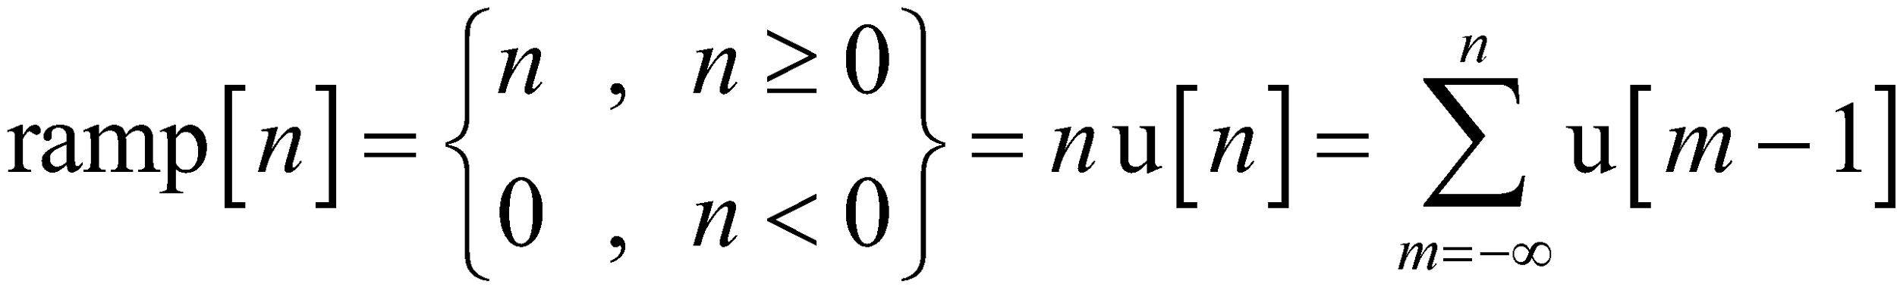
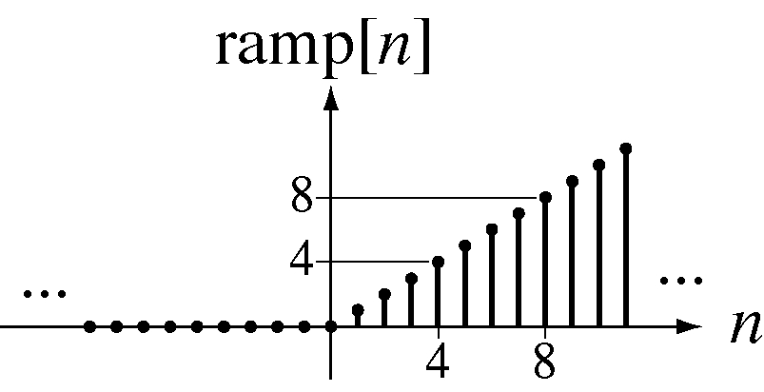
The Unit Ramp Function
M. J. Roberts - All Rights Reserved. Edited by Dr. Robert Akl
‹#›

Slide 15
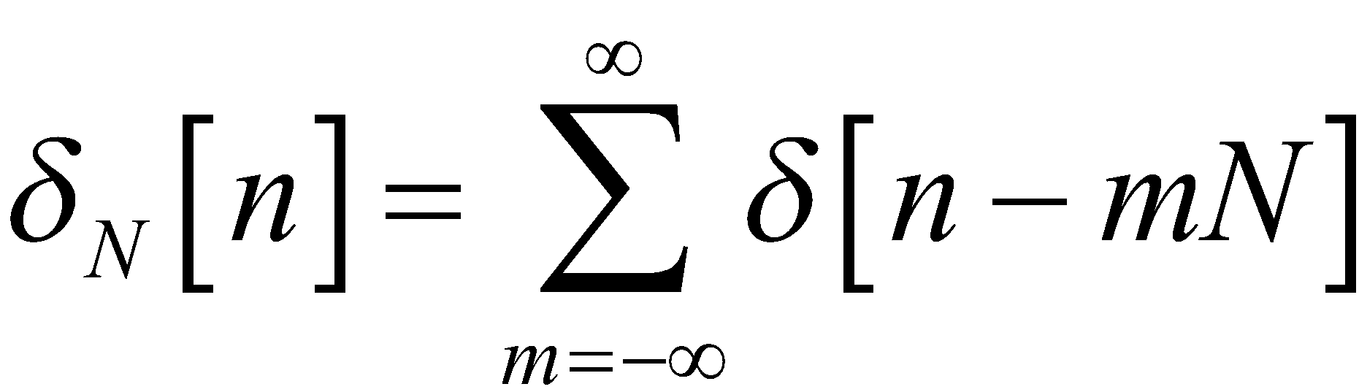
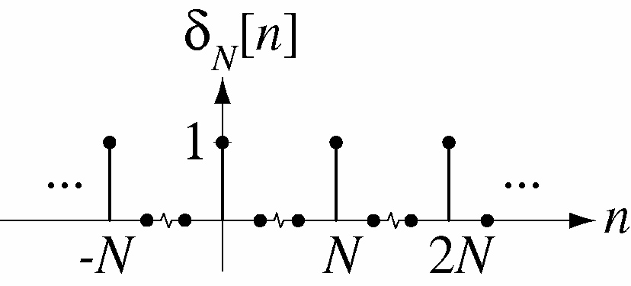
The Periodic Impulse Function
M. J. Roberts - All Rights Reserved. Edited by Dr. Robert Akl
‹#›

Slide 16
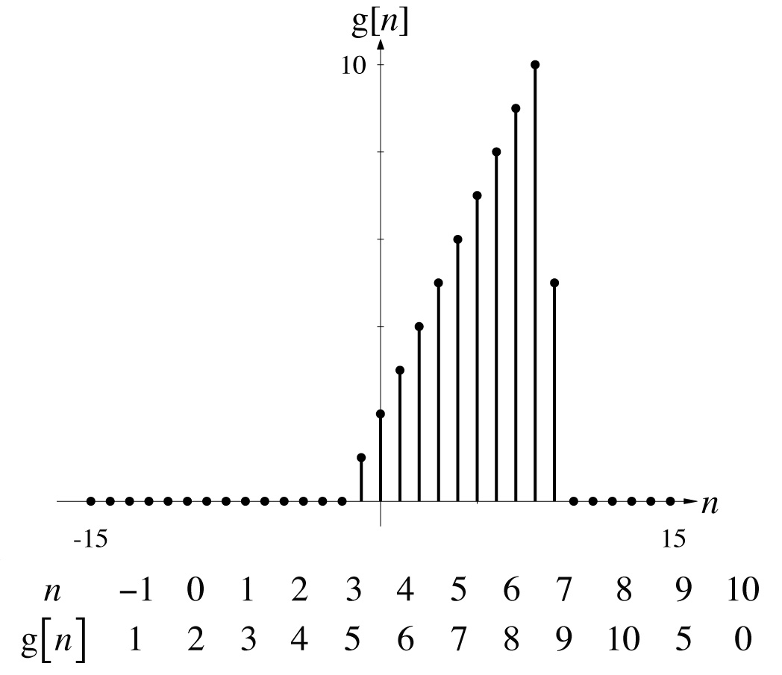
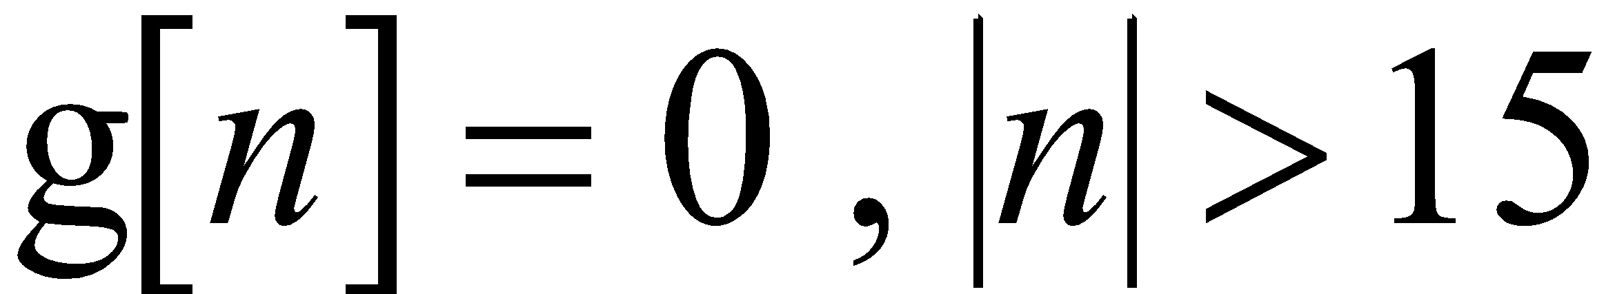
Scaling and Shifting Functions
M. J. Roberts - All Rights Reserved. Edited by Dr. Robert Akl
‹#›

Slide 17
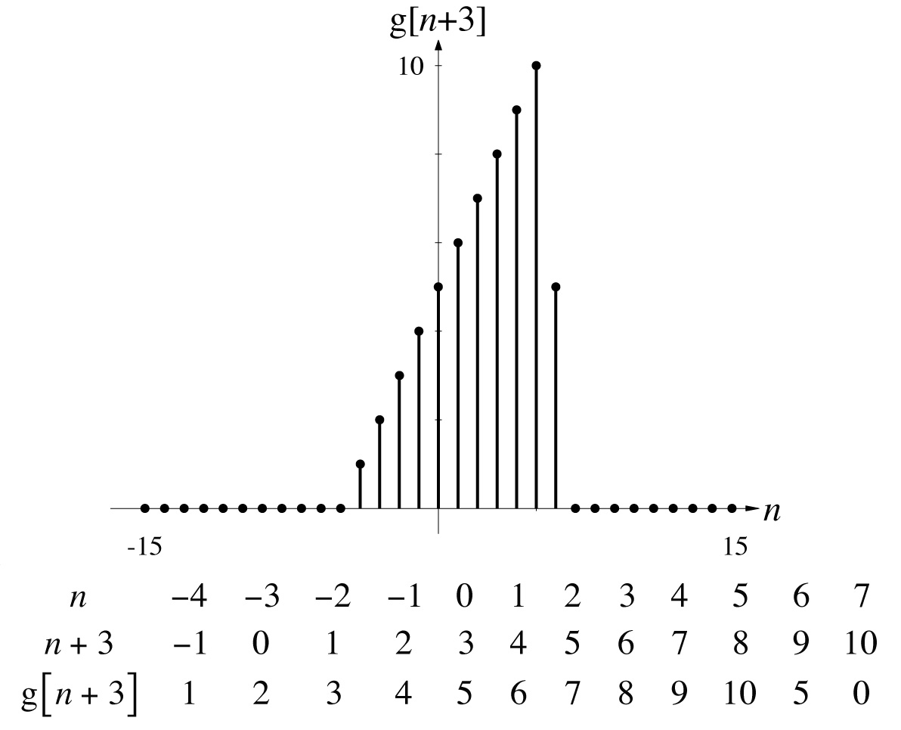
Scaling and Shifting Functions
M. J. Roberts - All Rights Reserved. Edited by Dr. Robert Akl
‹#›

Slide 18
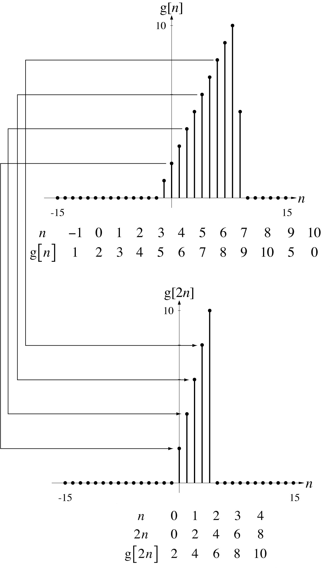
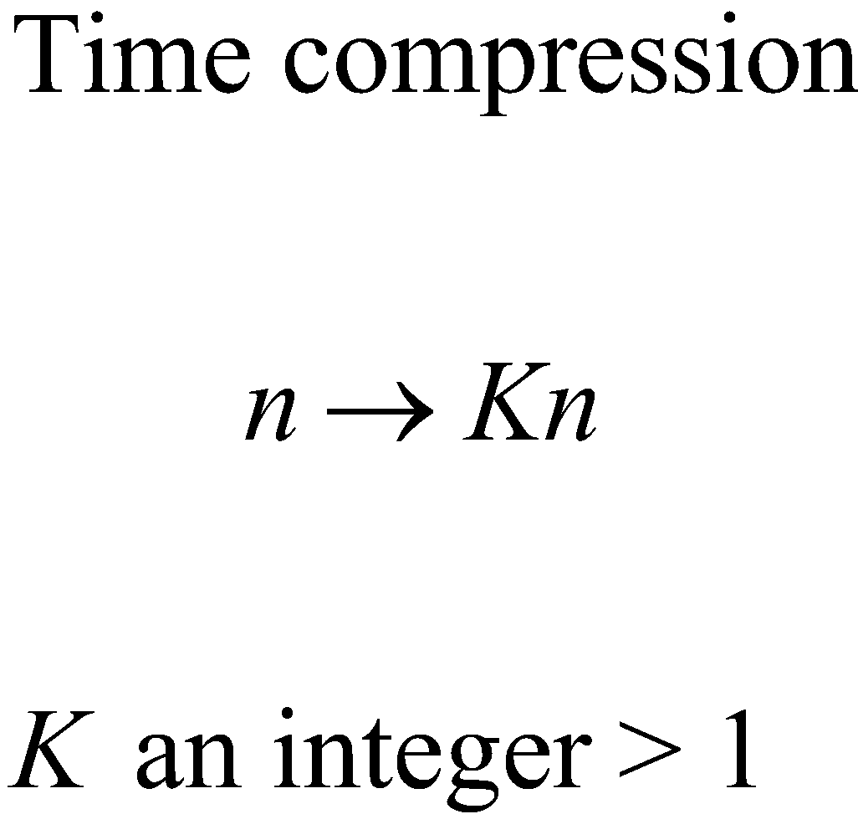
Scaling and Shifting Functions
M. J. Roberts - All Rights Reserved. Edited by Dr. Robert Akl
‹#›

Slide 19
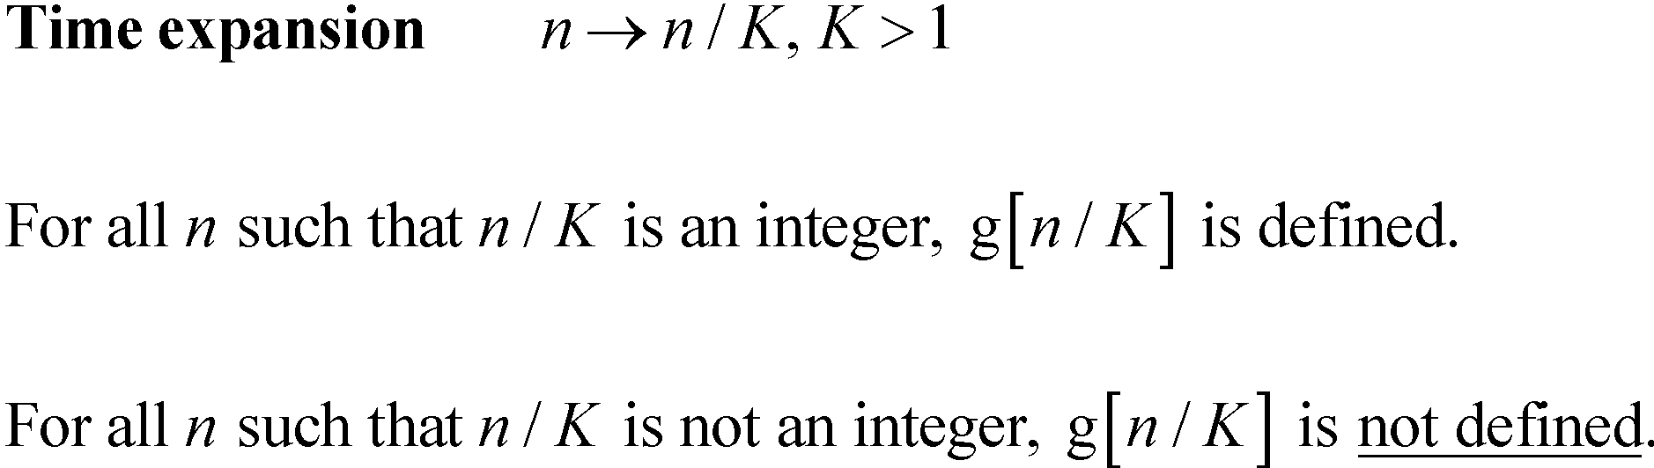
Scaling and Shifting Functions
M. J. Roberts - All Rights Reserved. Edited by Dr. Robert Akl
‹#›

Slide 20
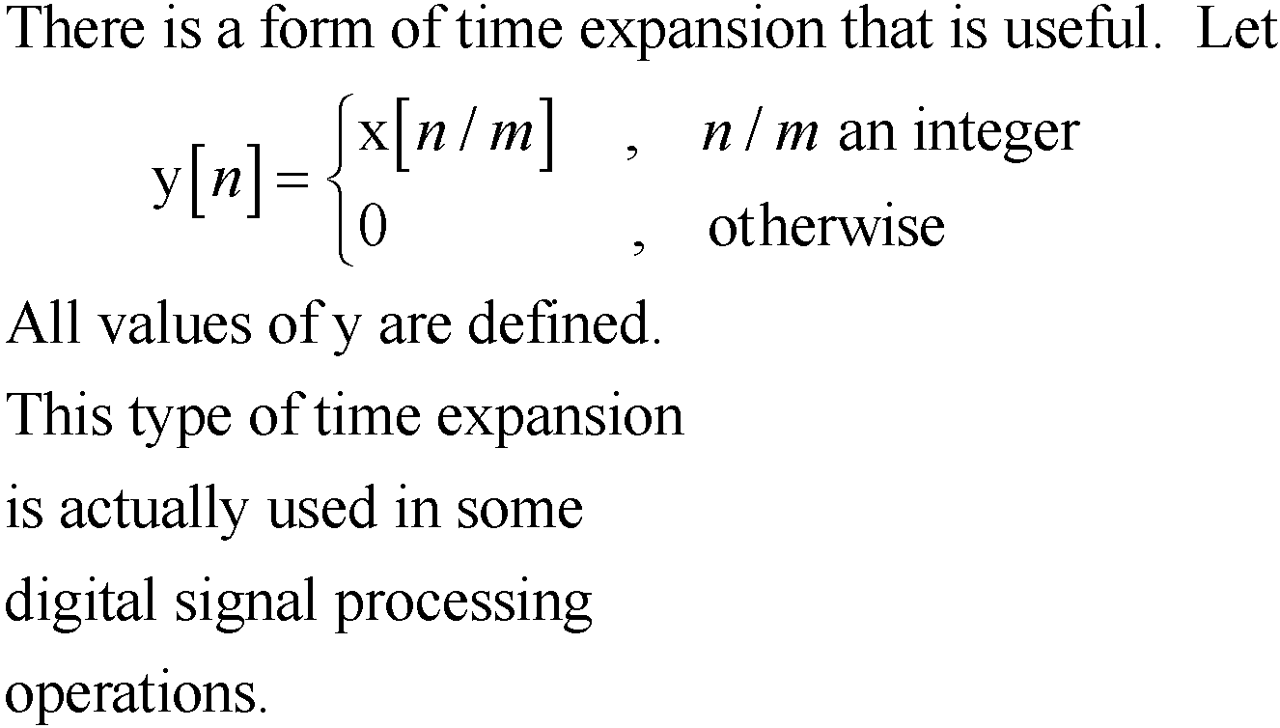
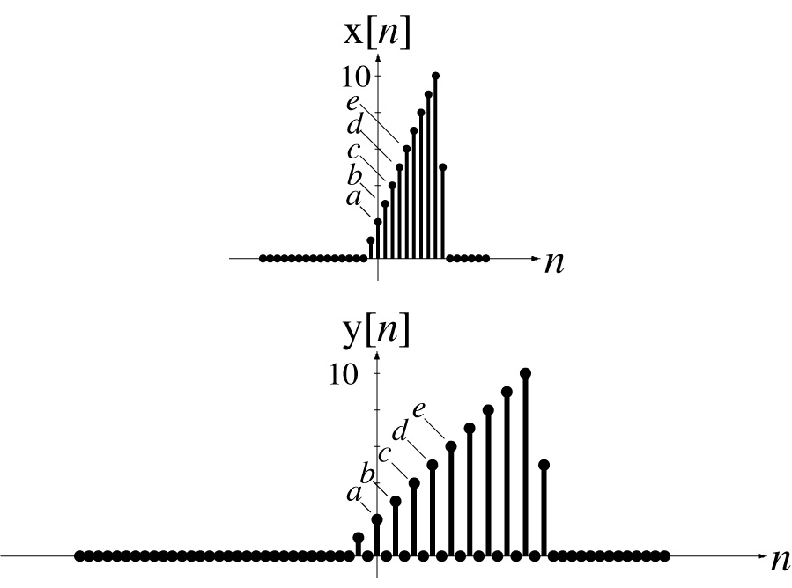
Scaling and Shifting Functions
M. J. Roberts - All Rights Reserved. Edited by Dr. Robert Akl
‹#›

Slide 21
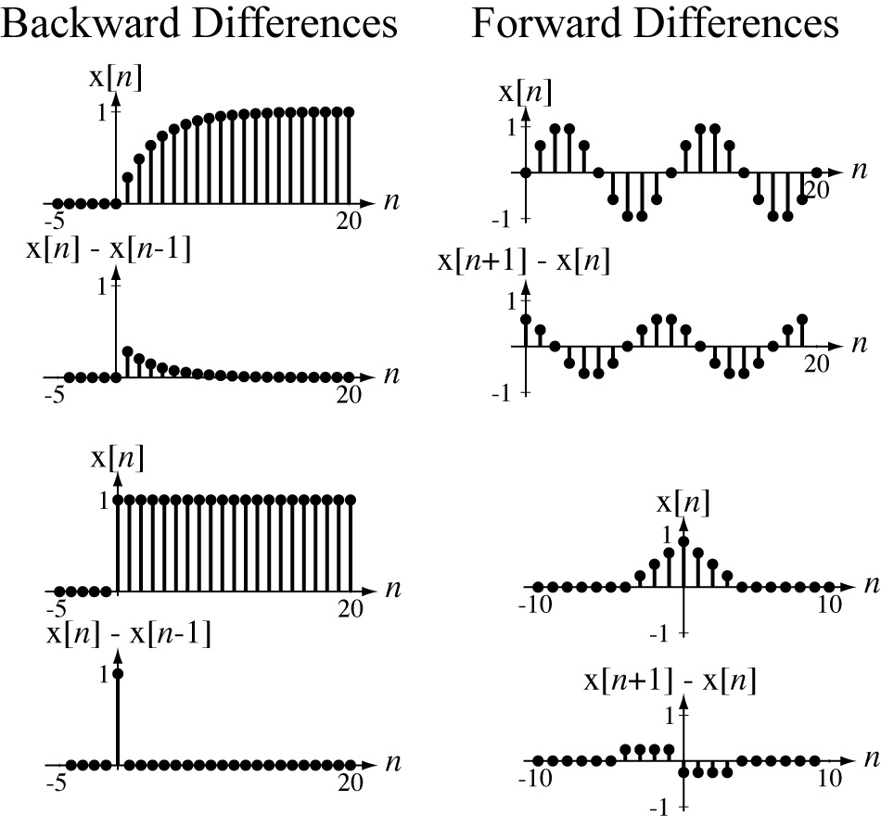
Differencing
M. J. Roberts - All Rights Reserved. Edited by Dr. Robert Akl
‹#›

Slide 22
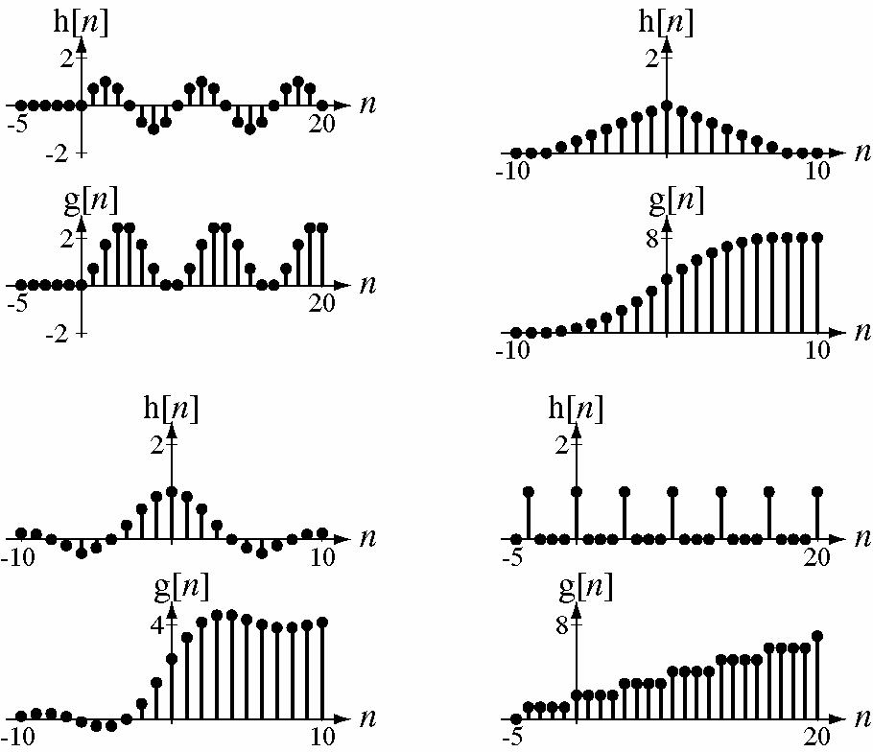
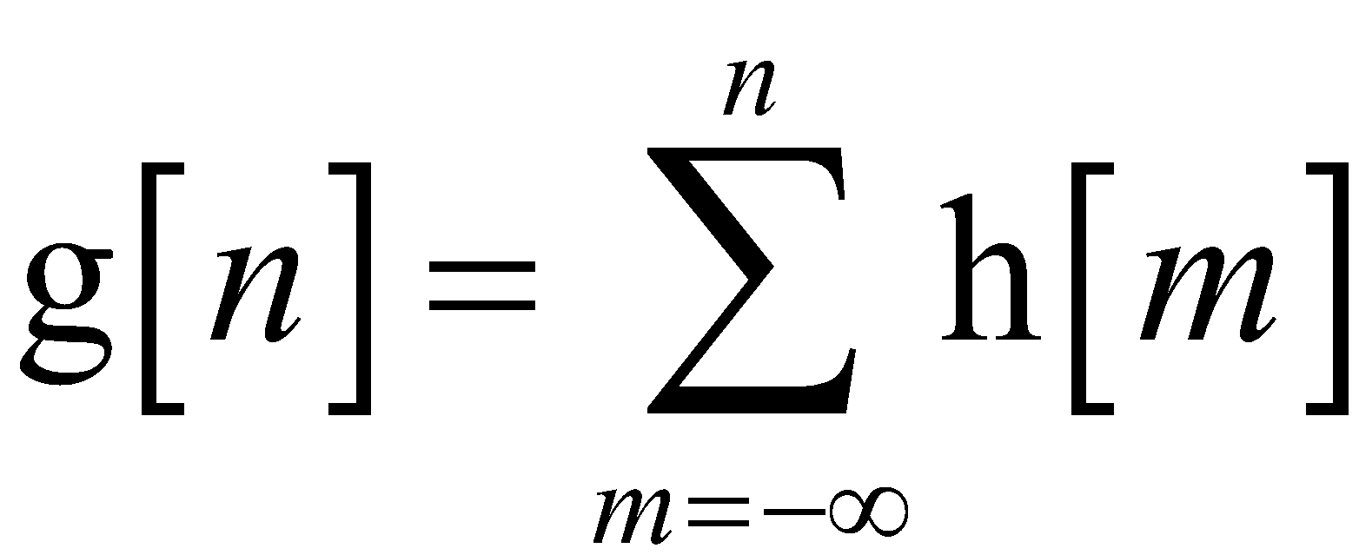
Accumulation
M. J. Roberts - All Rights Reserved. Edited by Dr. Robert Akl
‹#›

Slide 23
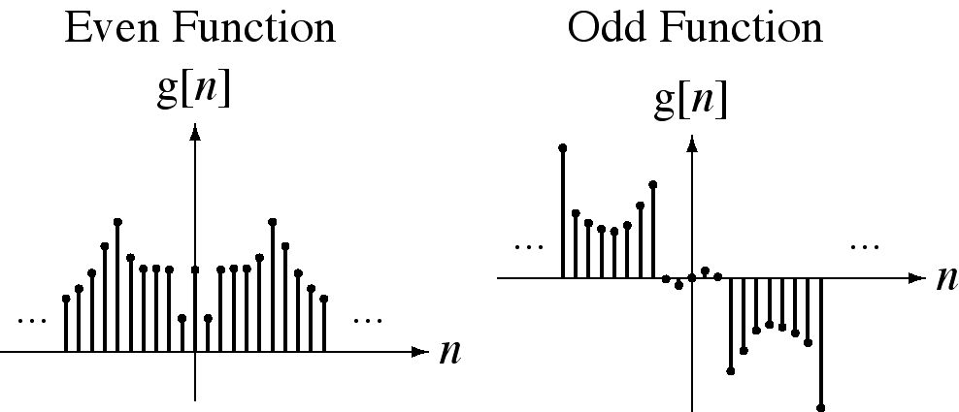
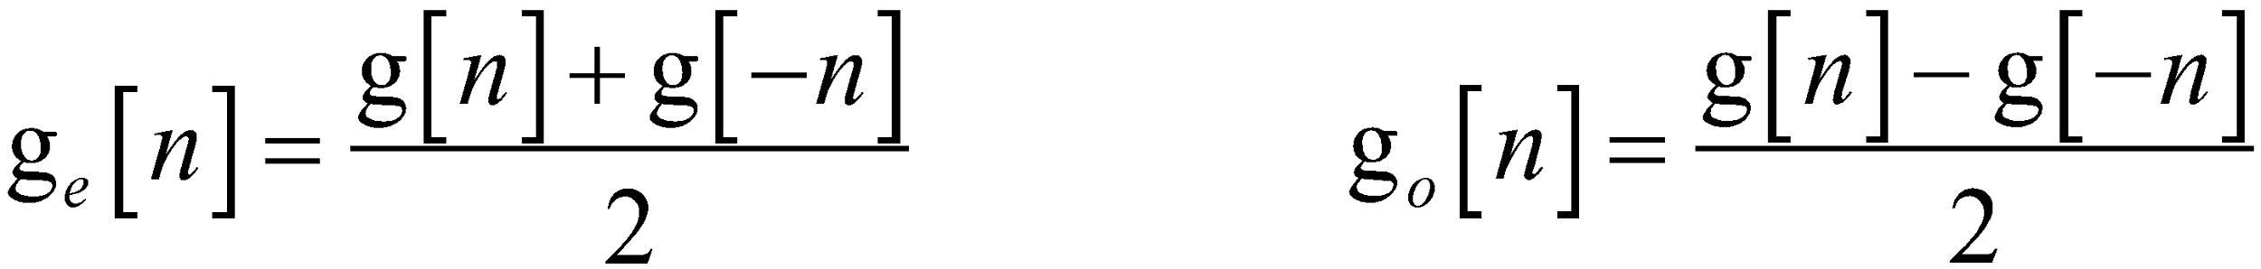
Even and Odd Signals
M. J. Roberts - All Rights Reserved. Edited by Dr. Robert Akl
‹#›

Slide 24
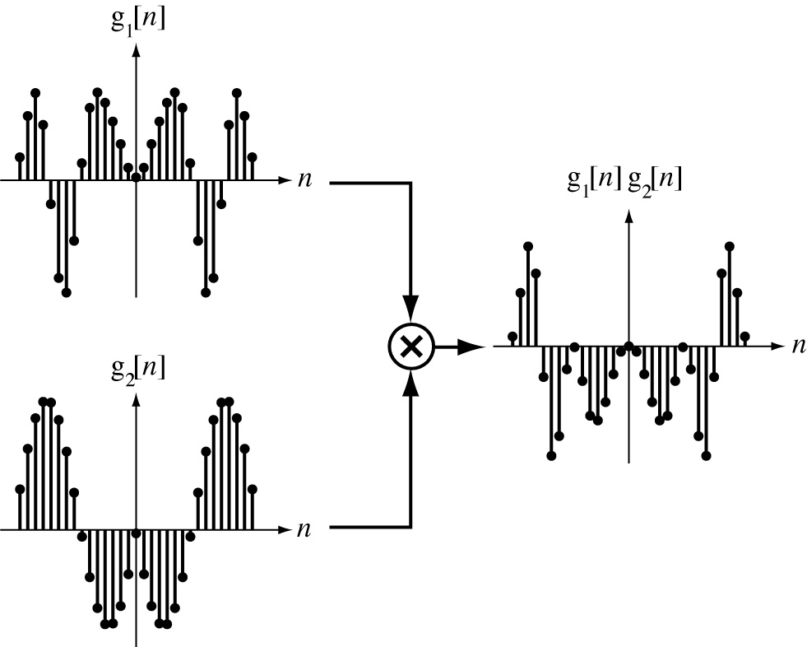
Products of Even and Odd Functions
Two Even Functions
M. J. Roberts - All Rights Reserved. Edited by Dr. Robert Akl
‹#›

Slide 25
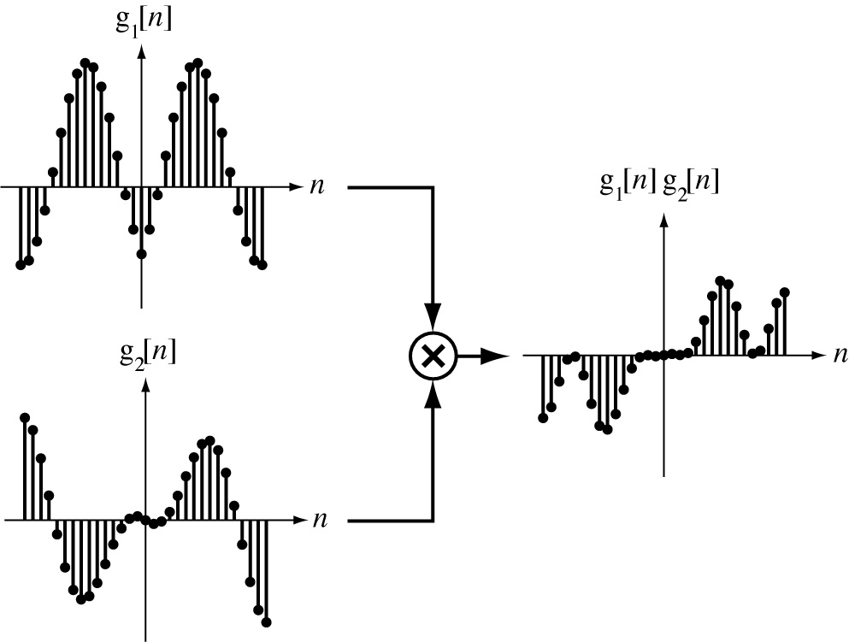
Products of Even and Odd Functions
An Even Function and an Odd Function
M. J. Roberts - All Rights Reserved. Edited by Dr. Robert Akl
‹#›

Slide 26
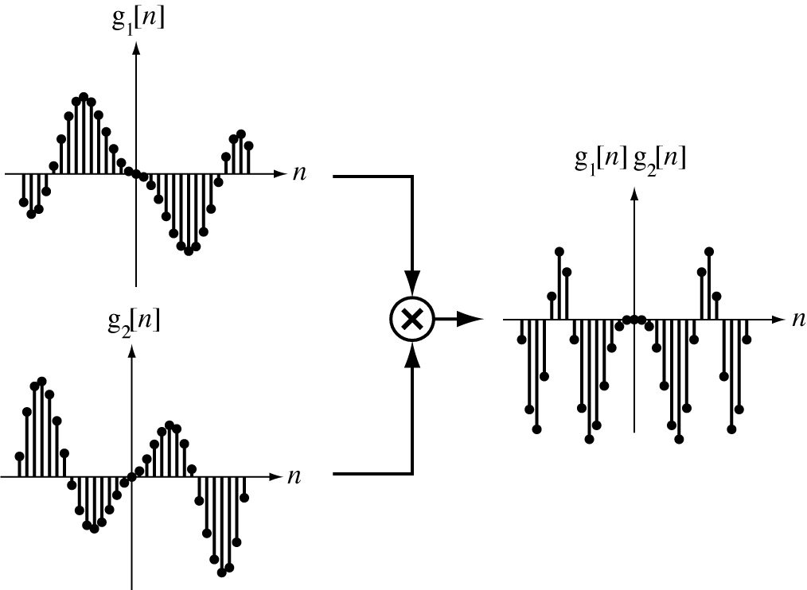
Products of Even and Odd Functions
Two Odd Functions
M. J. Roberts - All Rights Reserved. Edited by Dr. Robert Akl
‹#›

Slide 27
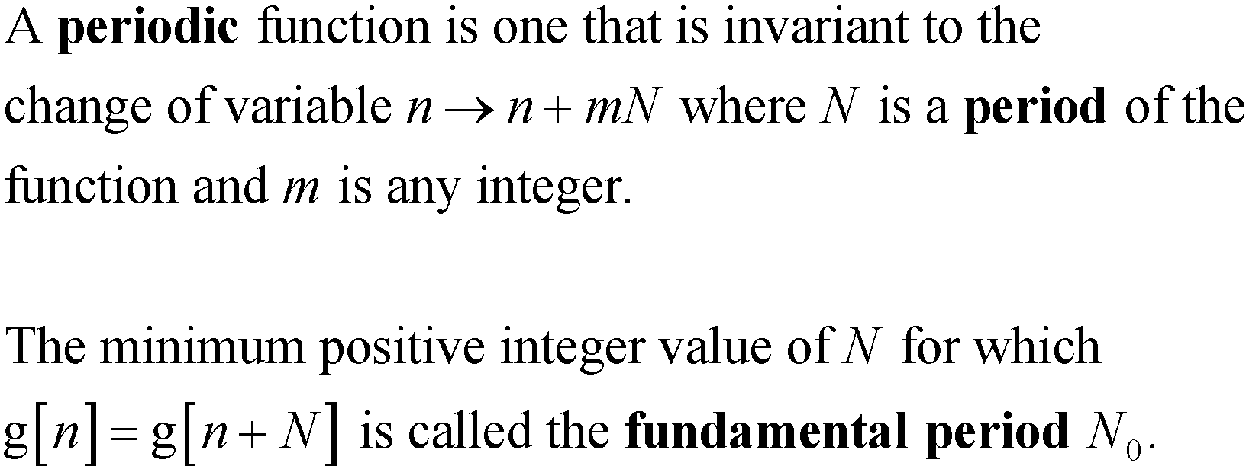
Periodic Functions
M. J. Roberts - All Rights Reserved. Edited by Dr. Robert Akl
‹#›

Slide 28
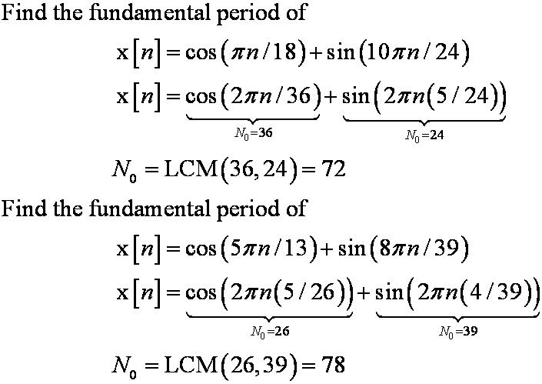
Periodic Functions
M. J. Roberts - All Rights Reserved. Edited by Dr. Robert Akl
‹#›

Slide 29
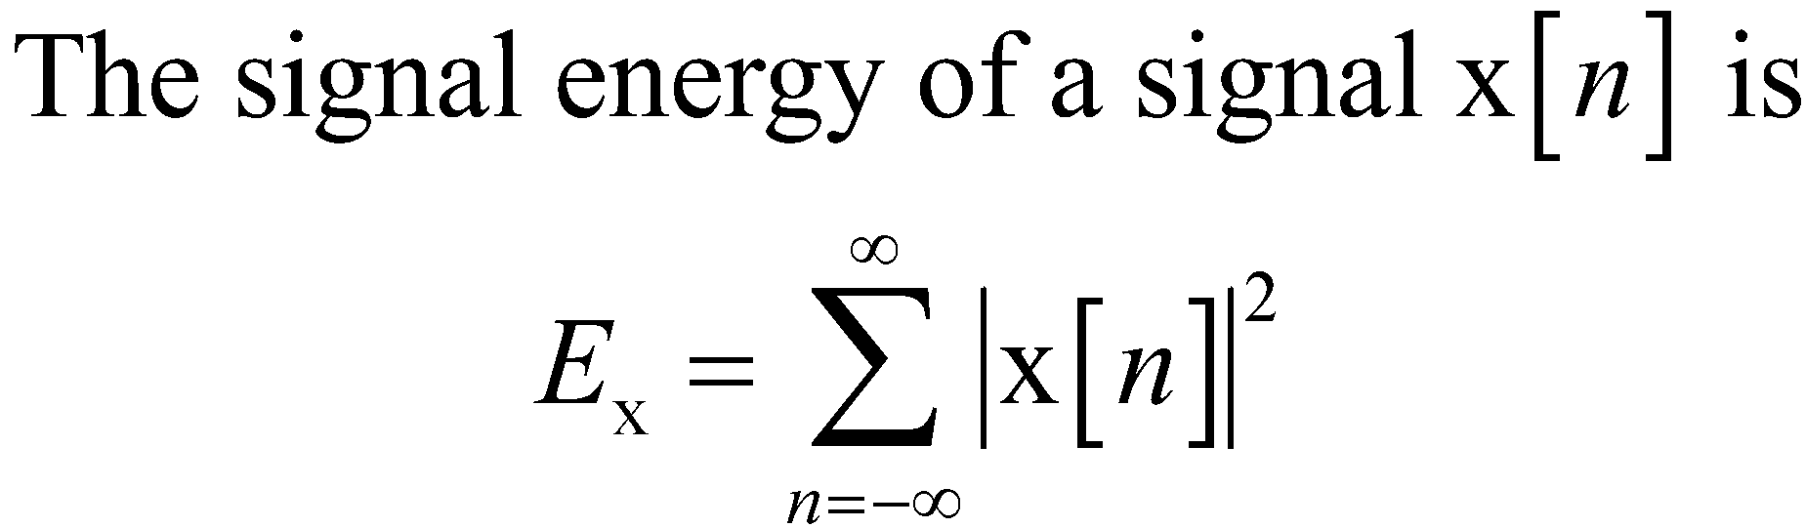
Signal Energy and Power
M. J. Roberts - All Rights Reserved. Edited by Dr. Robert Akl
‹#›

Slide 30
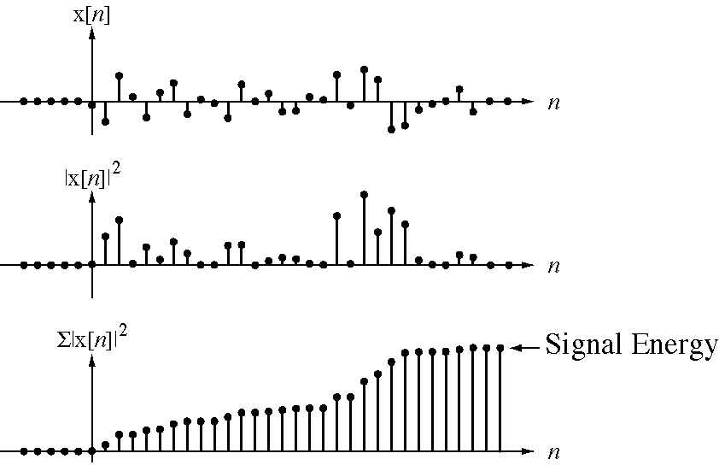
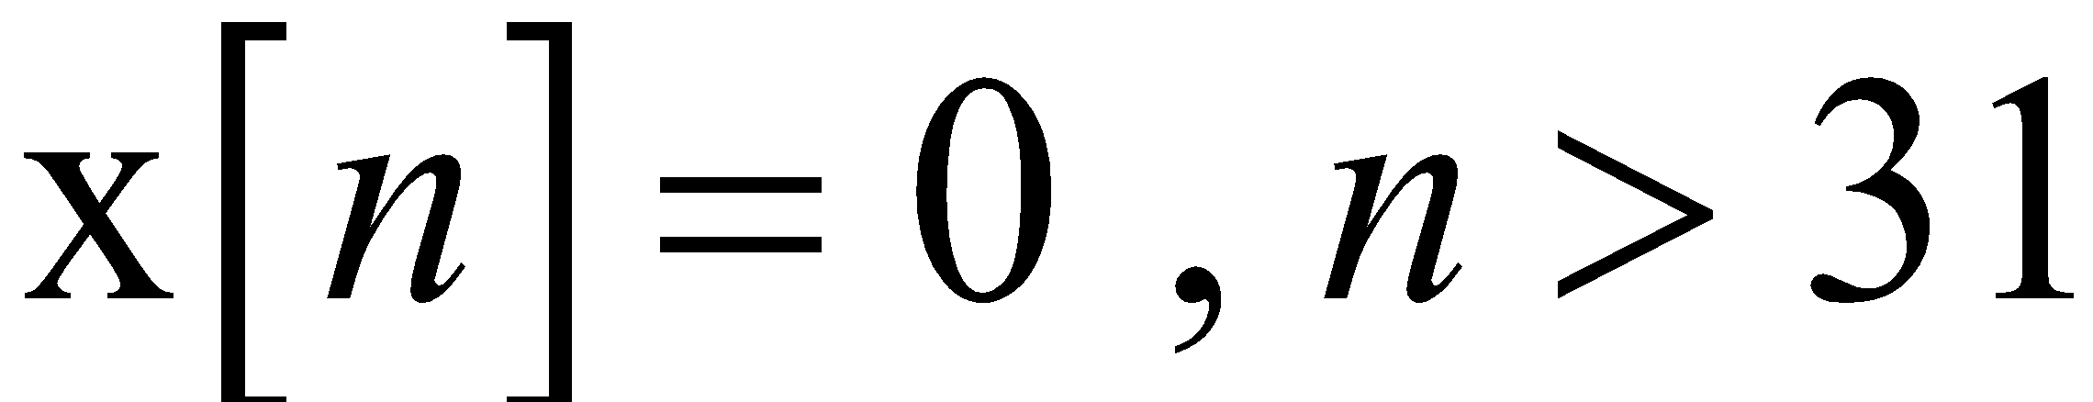
Signal Energy and Power
M. J. Roberts - All Rights Reserved. Edited by Dr. Robert Akl
‹#›

Slide 31
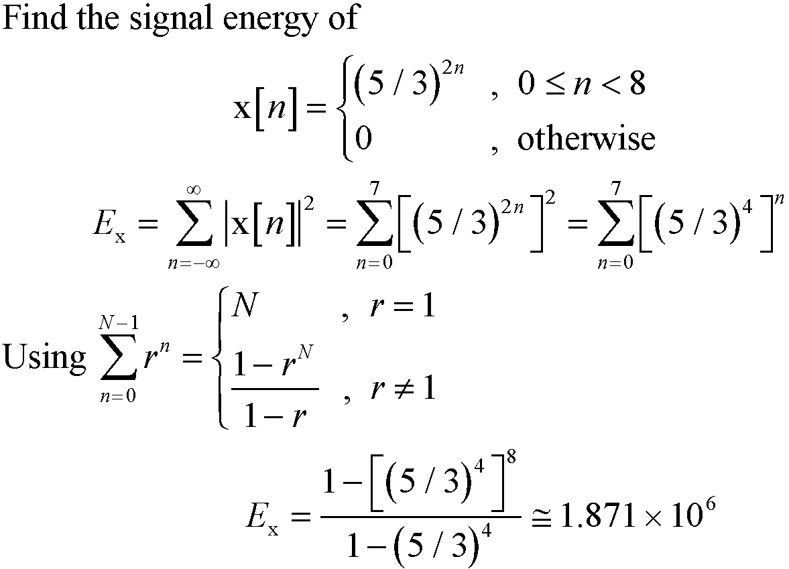
Signal Energy and Power
M. J. Roberts - All Rights Reserved. Edited by Dr. Robert Akl
‹#›

Slide 32
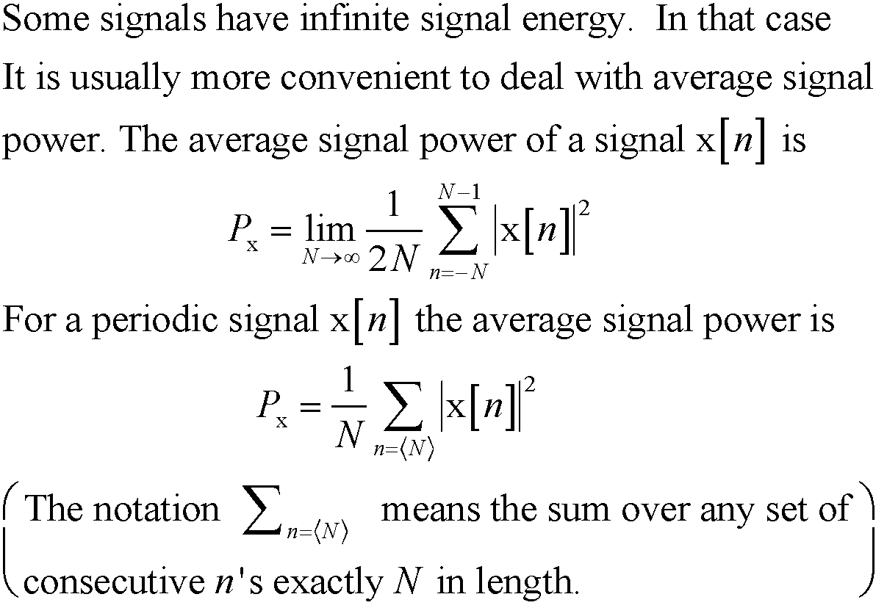
Signal Energy and Power
M. J. Roberts - All Rights Reserved. Edited by Dr. Robert Akl
‹#›

Slide 33
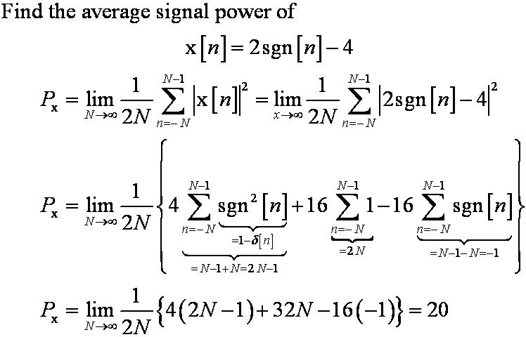
Signal Energy and Power
M. J. Roberts - All Rights Reserved. Edited by Dr. Robert Akl
‹#›

Slide 34
Signal Energy and Power
A signal with finite signal energy is
called an energy signal.
A signal with infinite signal energy and
finite average signal power is called a
power signal.
M. J. Roberts - All Rights Reserved. Edited by Dr. Robert Akl
‹#›

